Slide 1
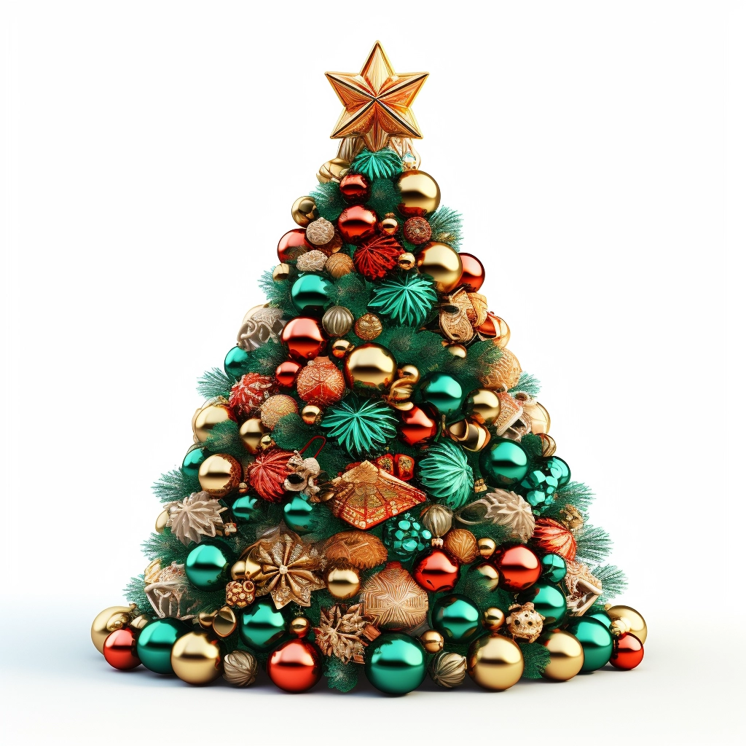

Do you understand where your models live?
HIGH DIMENSIONS
Paul Dubois - MICS Christmas day 2023
Notes:
Paper + token intro
=> things impossible in low dimensions may become possible in higher dimension

Slide 2
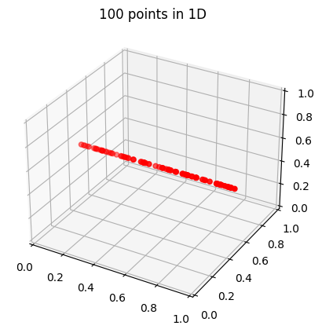
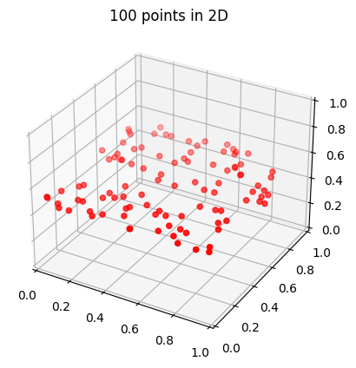
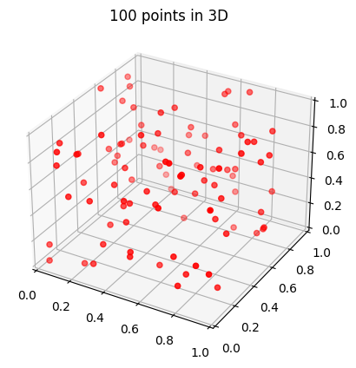
Curse of dimensionality
Notes:
For high dimensional pbs, we need A LOT of data

Slide 3
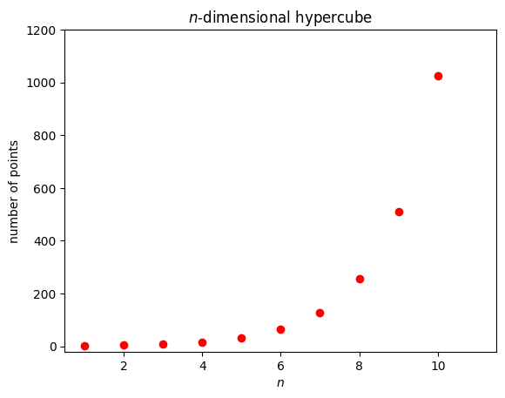
Curse of dimensionality
Notes:
Please don’t do grid search in high dimension

Slide 4
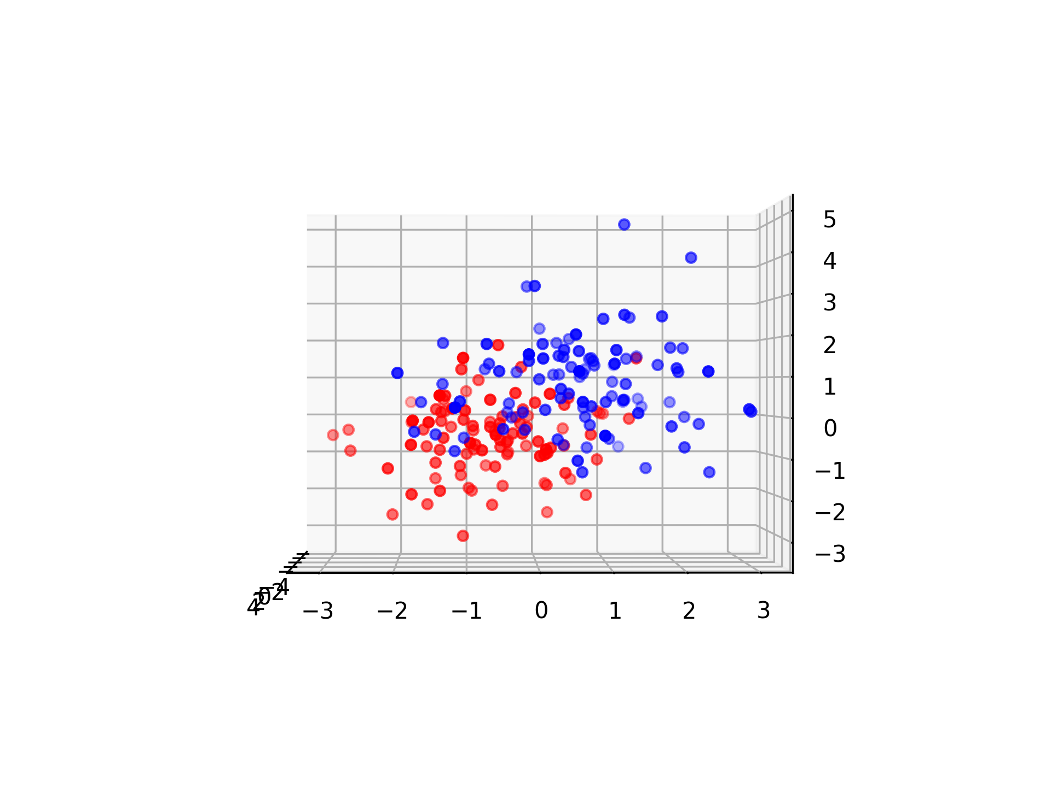
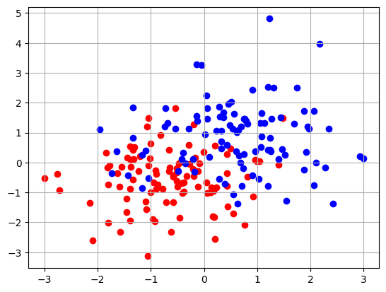
Blessing of dimensionality
Notes:
Seems hard to separate the two classes in 2D…

Slide 5
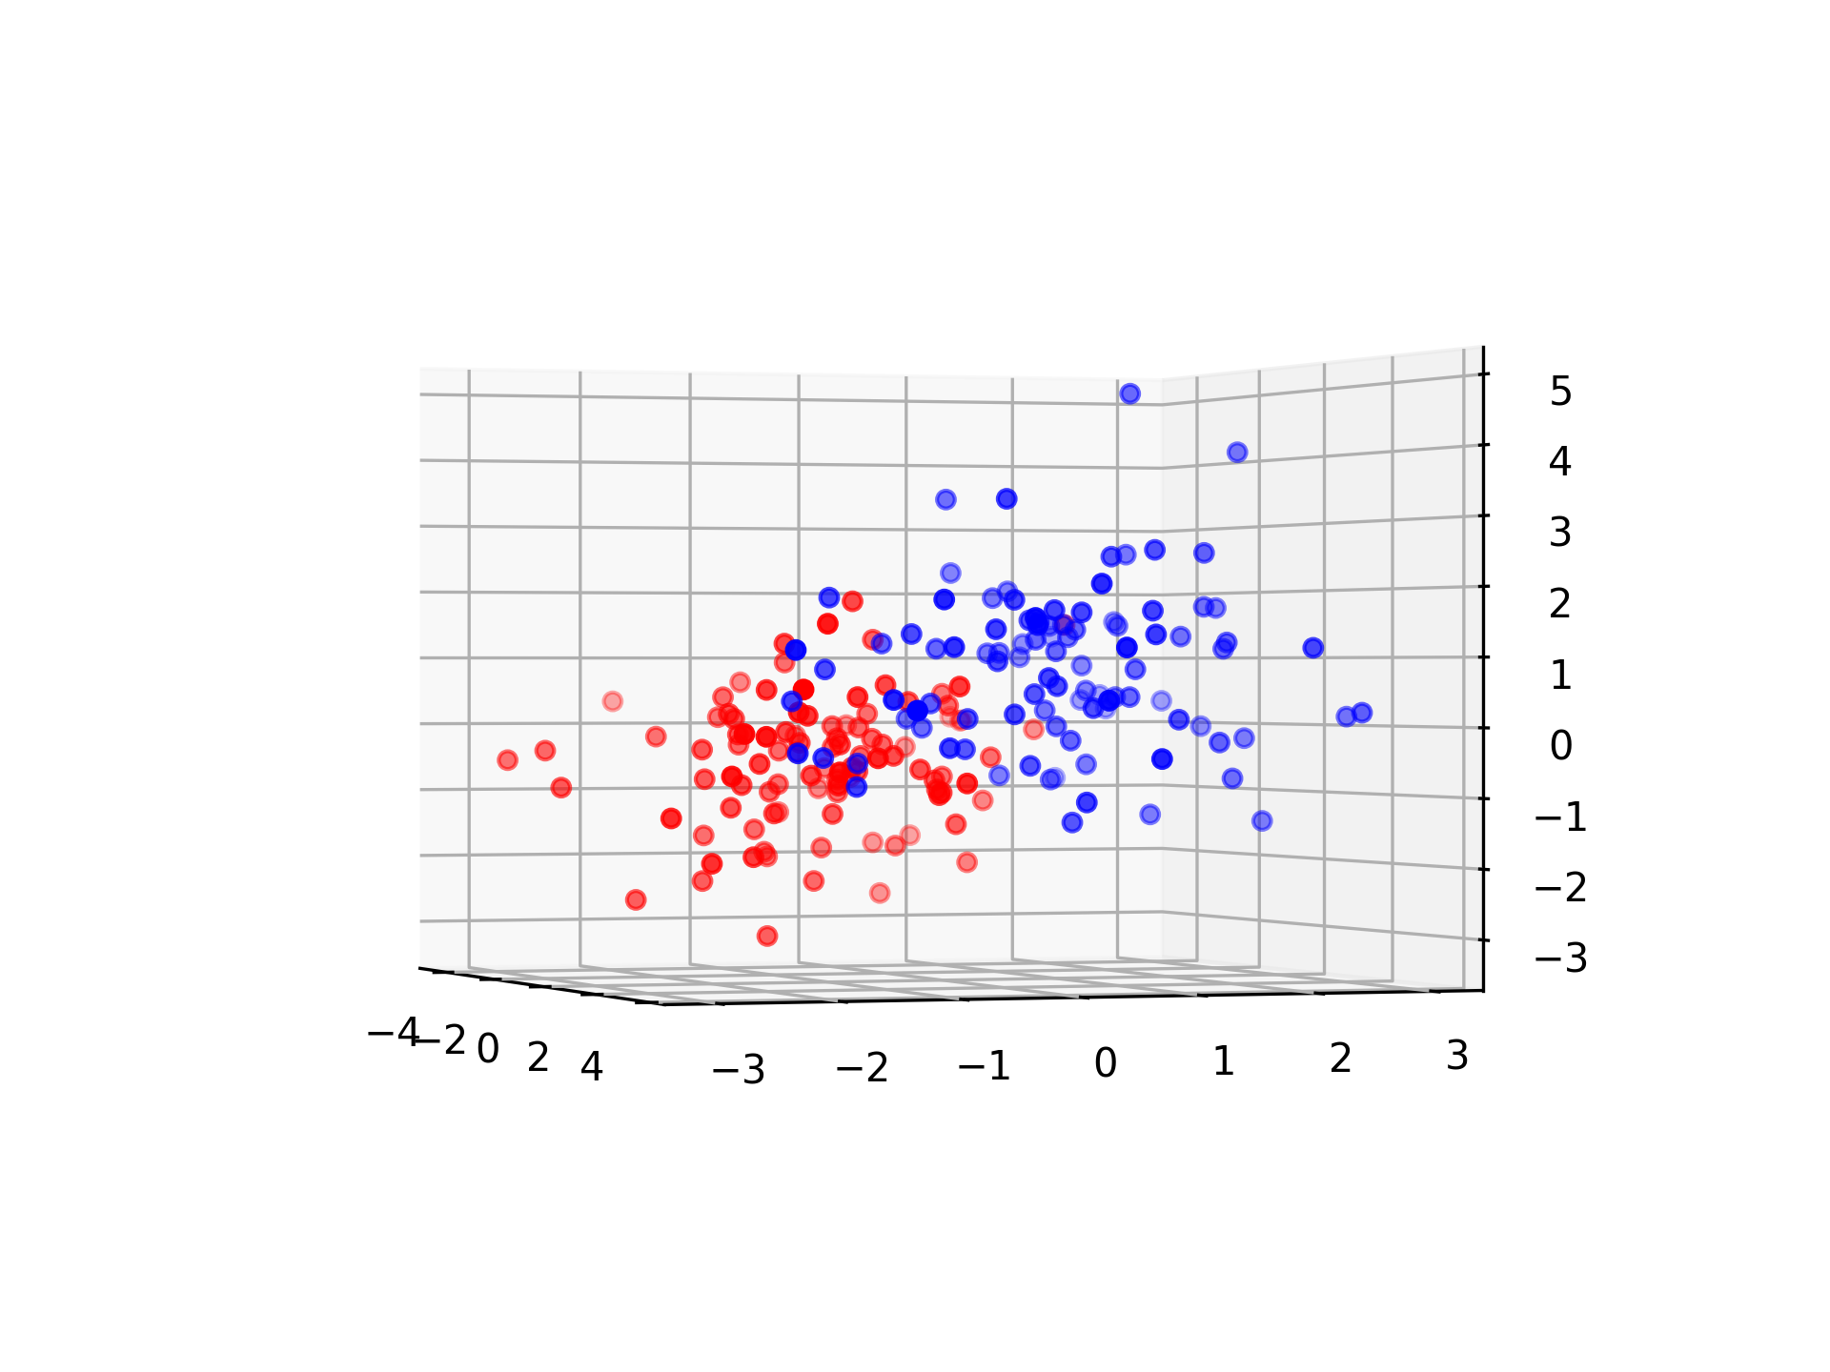
Blessing of dimensionality

Slide 6
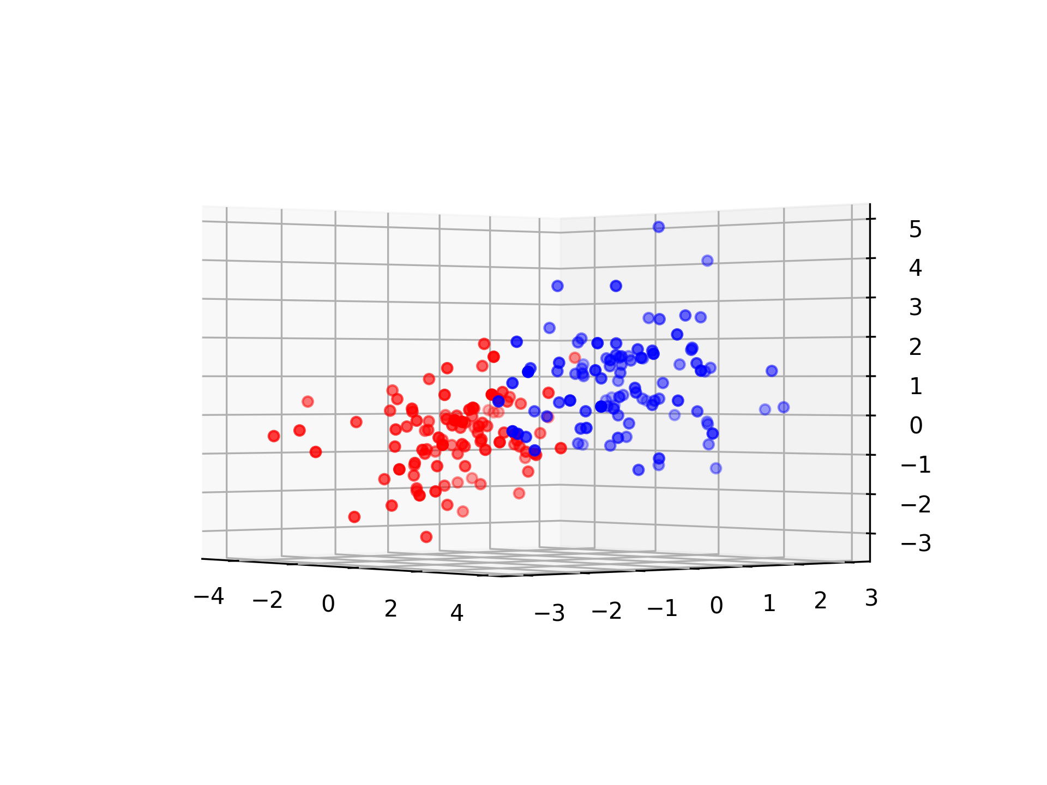
Blessing of dimensionality

Slide 7
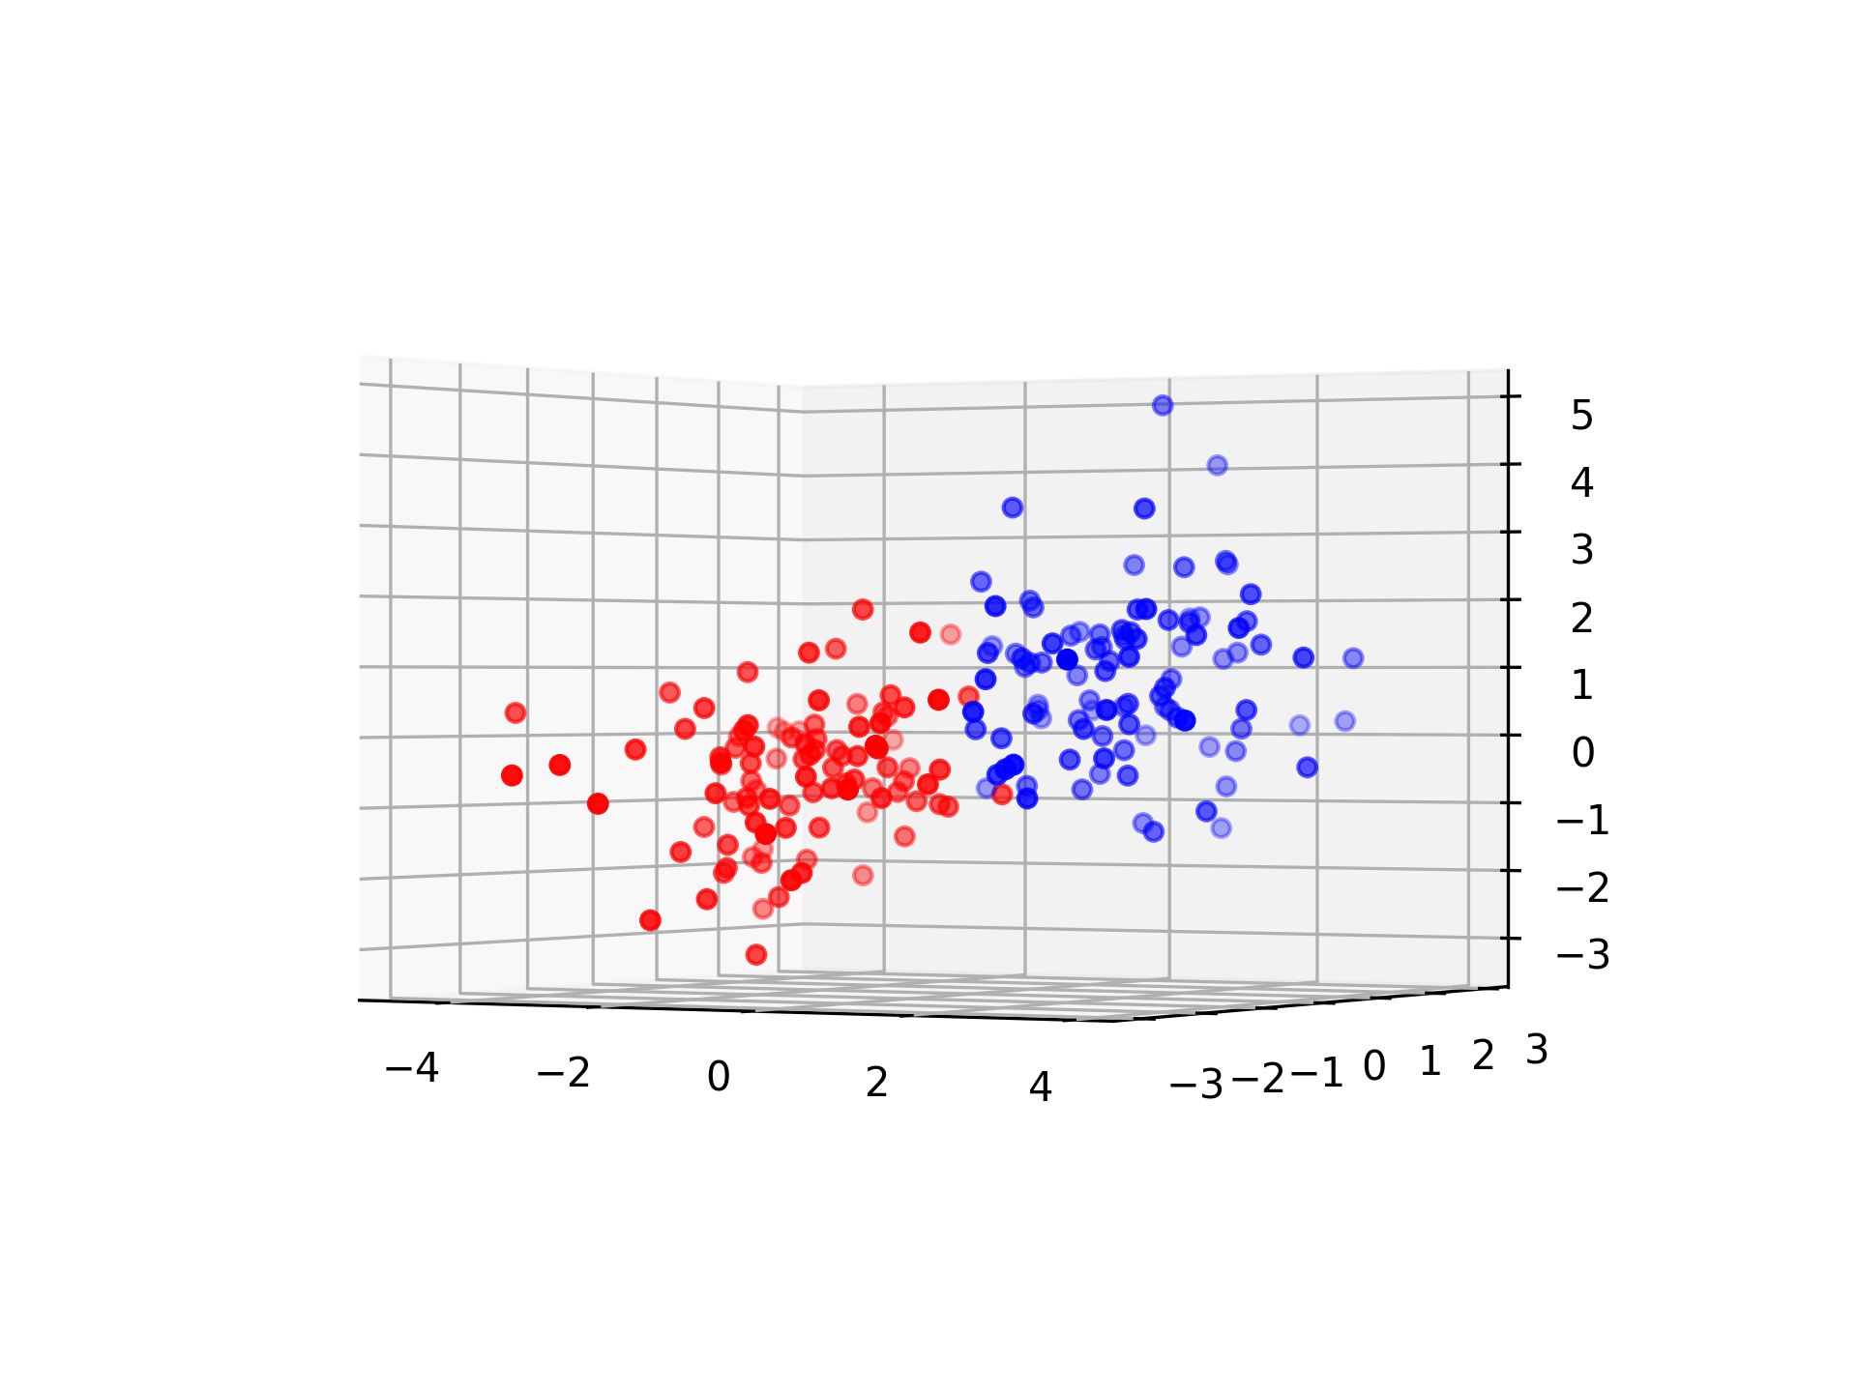
Blessing of dimensionality
Notes:
But the 3rd dimension might help!
=> higher dimensional model might allow more simple models

Slide 8
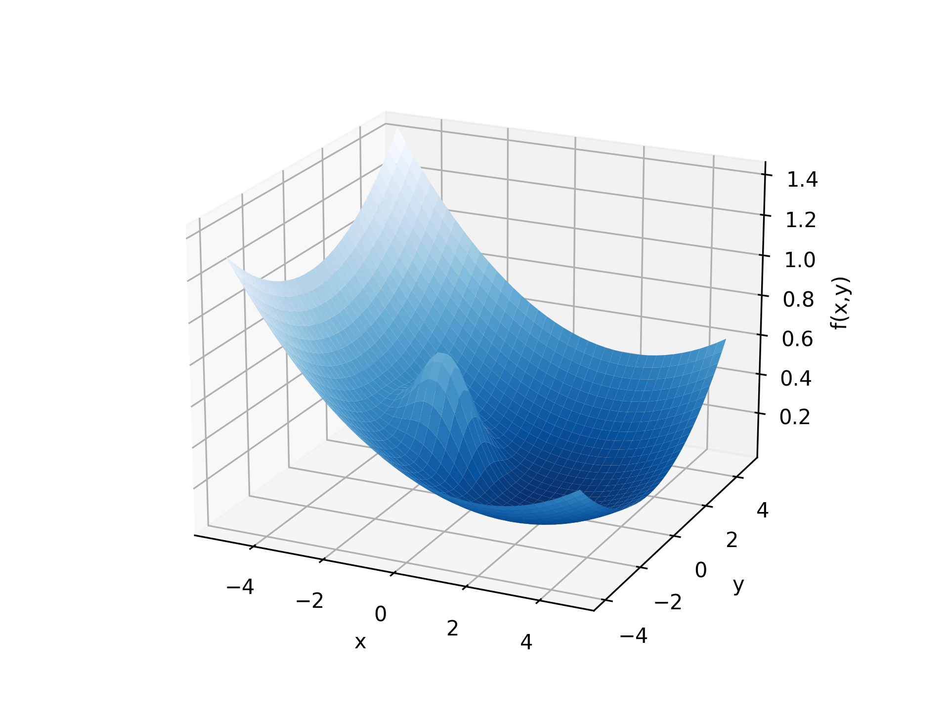
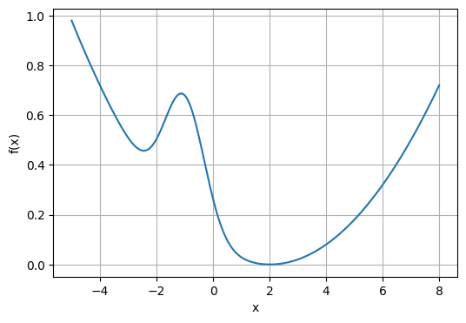
Blessing of dimensionality
Notes:
With gradient descent on the 1D function, we can get stuck in a local minimum
But the 2nd dimension may help!
=> Gradient descent is suitable for high dimensional models
The idea is that “there is (almost) always a direction that is not stuck”

Slide 9

Blessing of dimensionality

Slide 10

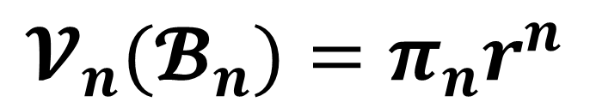
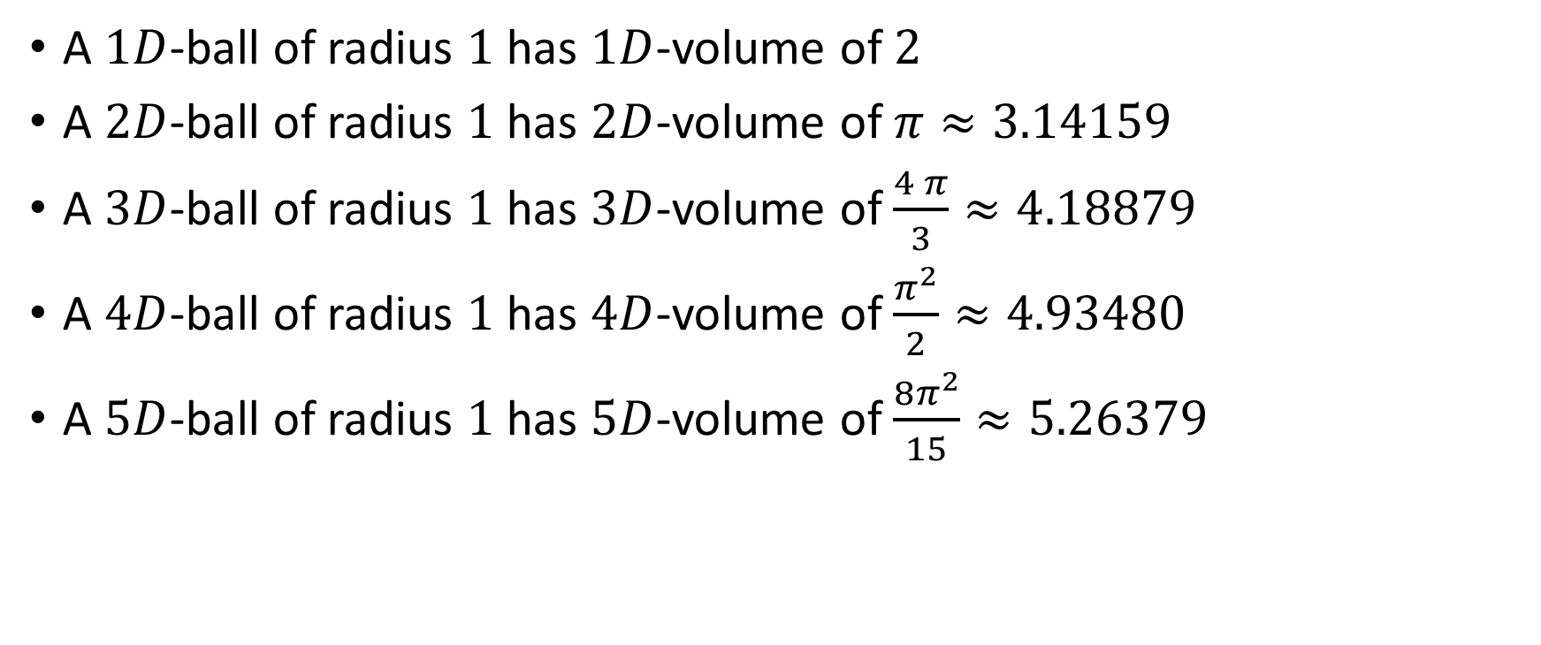
Higher dimensions of $π$
$$𝓥_{n}(𝓑_{n})=π_{n}r^{n}$$
(length)
(area)
A $1D$-ball of radius $1$ has $1D$-volume of $2$
A $2D$-ball of radius $1$ has $2D$-volume of $π≈3.14159$
A $3D$-ball of radius $1$ has $3D$-volume of $\frac{4 π}{3}≈4.18879$
A $4D$-ball of radius $1$ has $4D$-volume of $\frac{π^{2}}{2}≈4.93480$
A $5D$-ball of radius $1$ has $5D$-volume of $\frac{8π^{2}}{15}≈5.26379$
Notes:
Make audience guess for 3D, 4D (and 5D?)

Slide 11
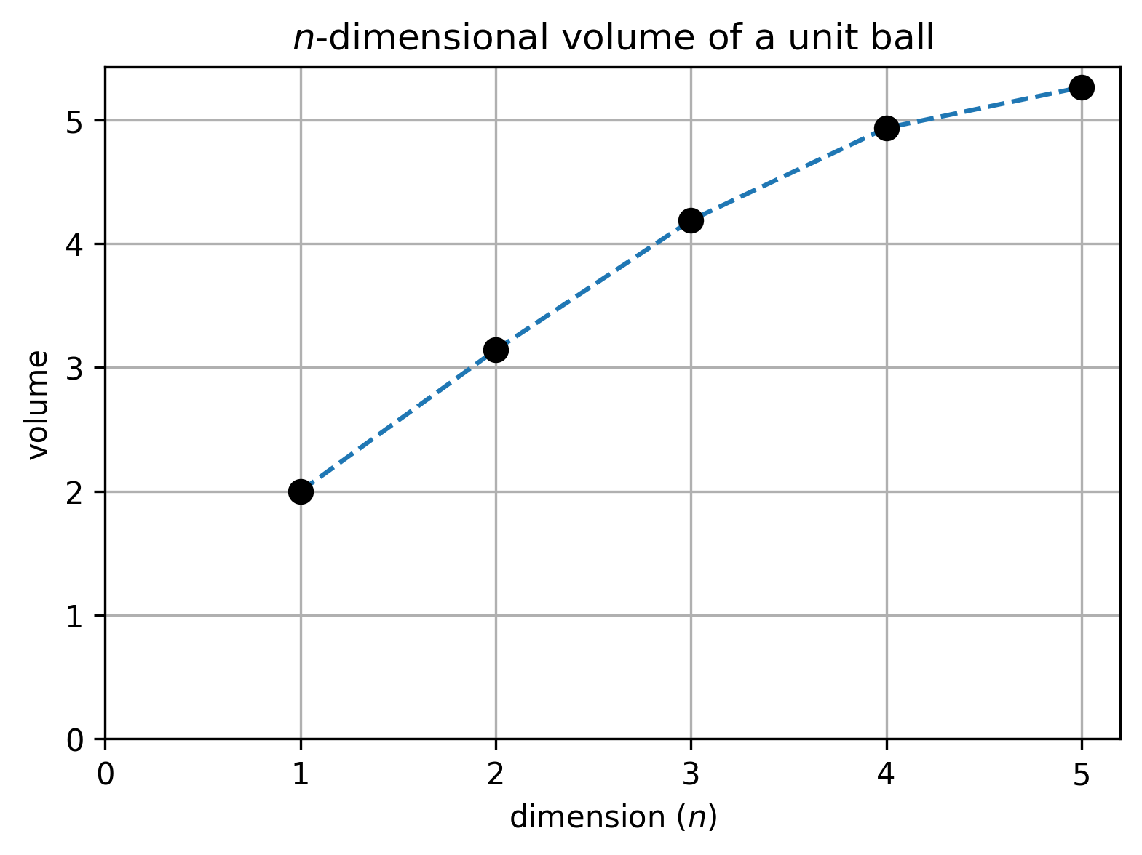
Higher dimensions of $π$
Notes:
“it makes sense that in higher dimensions, unknit balls have a larger volume”

Slide 12
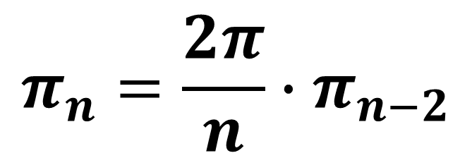
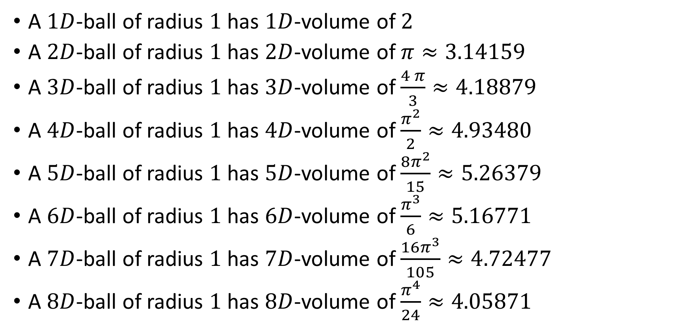
Higher dimensions of $π$
$$π_{n}=\frac{2π}{n}∙π_{n−2}$$
A $1D$-ball of radius $1$ has $1D$-volume of $2$
A $2D$-ball of radius $1$ has $2D$-volume of $π≈3.14159$
A $3D$-ball of radius $1$ has $3D$-volume of $\frac{4 π}{3}≈4.18879$
A $4D$-ball of radius $1$ has $4D$-volume of $\frac{π^{2}}{2}≈4.93480$
A $5D$-ball of radius $1$ has $5D$-volume of $\frac{8π^{2}}{15}≈5.26379$
A $6D$-ball of radius $1$ has $6D$-volume of $\frac{π^{3}}{6}≈5.16771$
A $7D$-ball of radius $1$ has $7D$-volume of $\frac{16π^{3}}{105}≈4.72477$
A $8D$-ball of radius $1$ has $8D$-volume of $\frac{π^{4}}{24}≈4.05871$

Slide 13
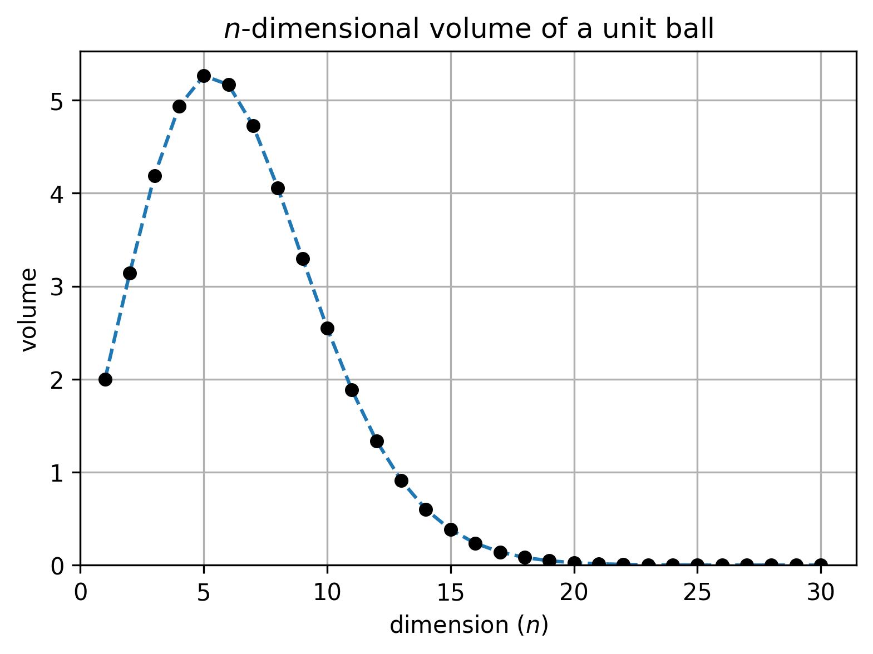
Higher dimensions of $π$
Notes:
Did you expect that?
=> “intuitional induction” from low dimensions are sometimes wrong
=> in high dimensions, unit balls are almost points (no volume) /!\ testing models with unit balls can be almost equivalent to testing with points

Slide 14
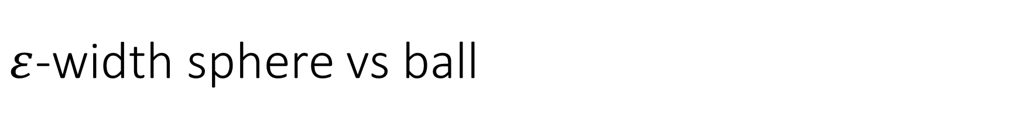
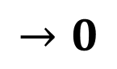
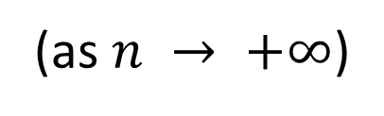
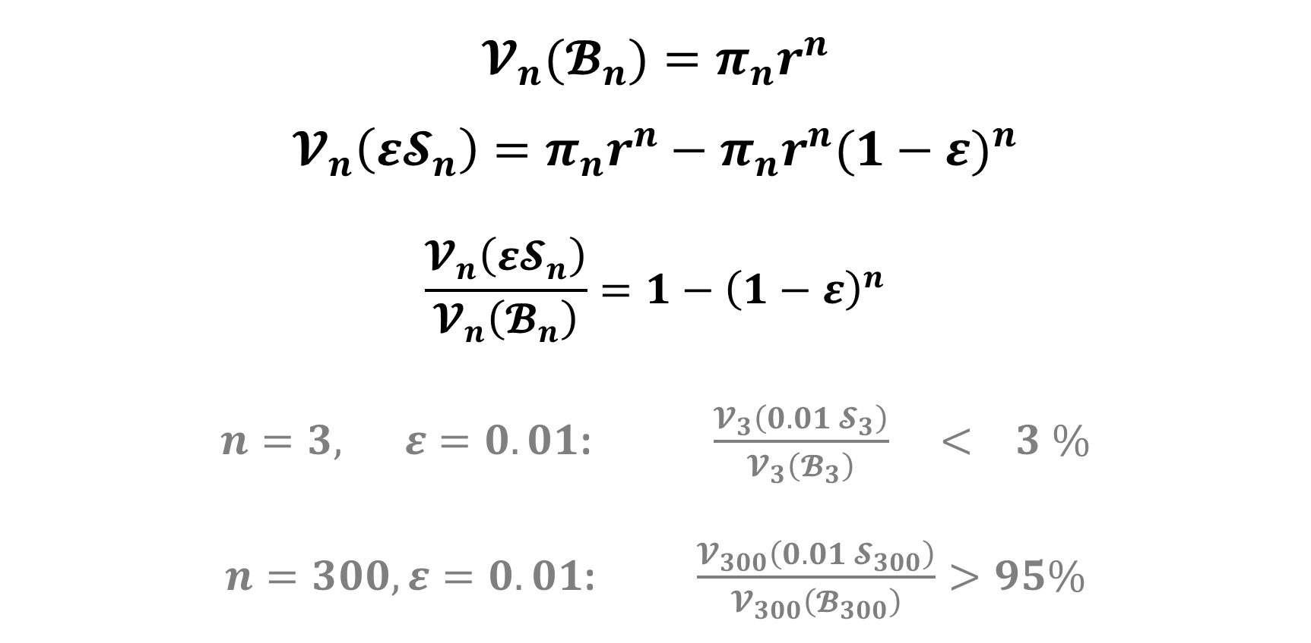
$ε$-width sphere vs ball
$$𝓥_{n}(𝓑_{n})=π_{n}r^{n}$$
$$𝓥_{n}\left({ε𝓢}_{n}\right)=π_{n}r^{n}−π_{n}r^{n}{(1−ε)}^{n}$$
$$\frac{𝓥_{n}\left({ε𝓢}_{n}\right)}{𝓥_{n}\left(𝓑_{n}\right)}=1−{\left(1−ε\right)}^{n}$$
$n=3, ε=0.01$: $\frac{𝓥_{3}\left(0.01 𝓢_{3}\right)}{𝓥_{3}\left(𝓑_{3}\right)} < 3 \%$
$n=300, ε=0.01$: $\frac{𝓥_{300}\left(0.01 𝓢_{300}\right)}{𝓥_{300}\left(𝓑_{300}\right)}>95\%$
$$→0$$
(as $n → +∞$)
Notes:
In high dimension, almost all the volume of a ball in on the boundary => both for unit AND non-unit balls!
=> testing models on spheres or balls is very similar

Slide 15
4 circles paradox

Slide 16
4 circles paradox

Slide 17
4 circles paradox
(-2,2)
(2,2)
(-2,-2)
(2,-2)
Notes:
4x4 square, centered at origin

Slide 18

4 circles paradox
(-2,2)
(2,2)
$1$
(-1,1)
(1,1)
(-1,-1)
(1,-1)
(-2,-2)
(2,-2)
Notes:
Fit 4 non-intersecting unit circles

Slide 19
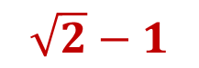
4 circles paradox
(-2,2)
(2,2)
$1$
(-1,1)
(1,1)
$\sqrt{2}−1$
(-1,-1)
(1,-1)
(-2,-2)
(2,-2)
Notes:
Make a circle centered at origin, the largest possible without intersecting the blue circles: its radius is $\sqrt{2}−1$

Slide 20
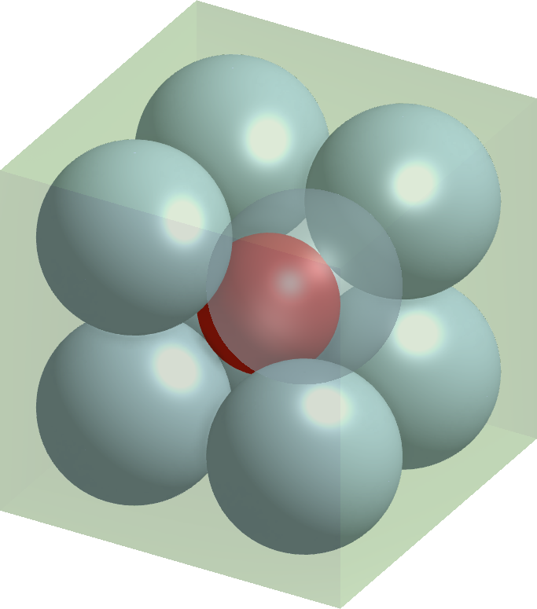
8 spheres paradox

Slide 21
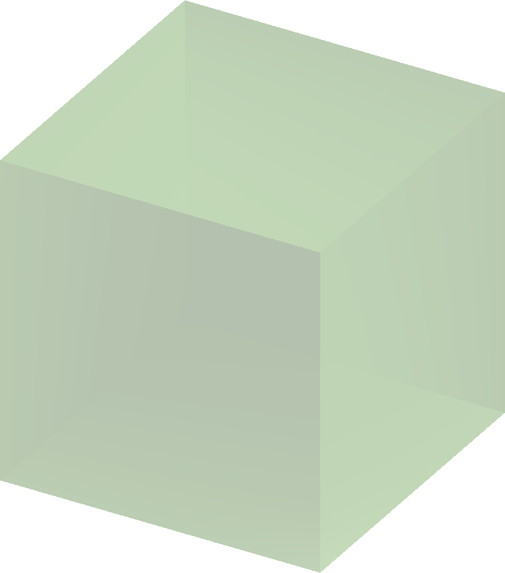
8 spheres paradox
4x4x4 cube
Notes:
4x4x4 cube, centered at origin

Slide 22
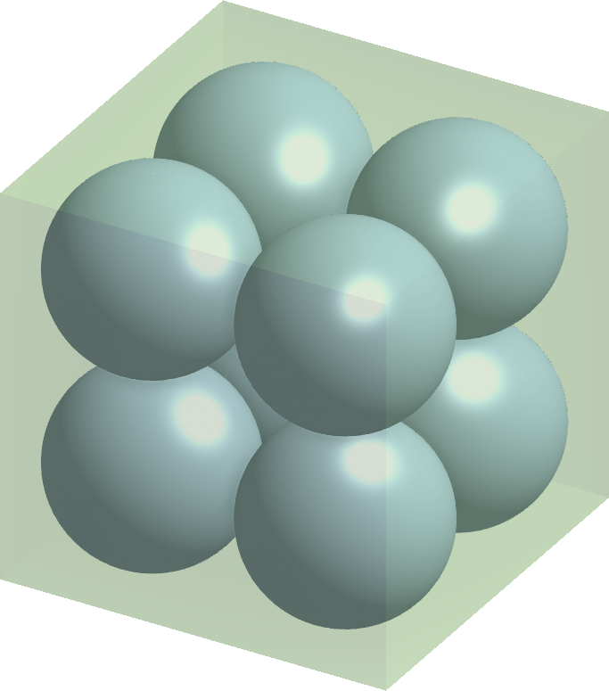
8 spheres paradox
4x4x4 cube
radius 1
Notes:
Fit 8 non-intersecting unit spheres

Slide 23
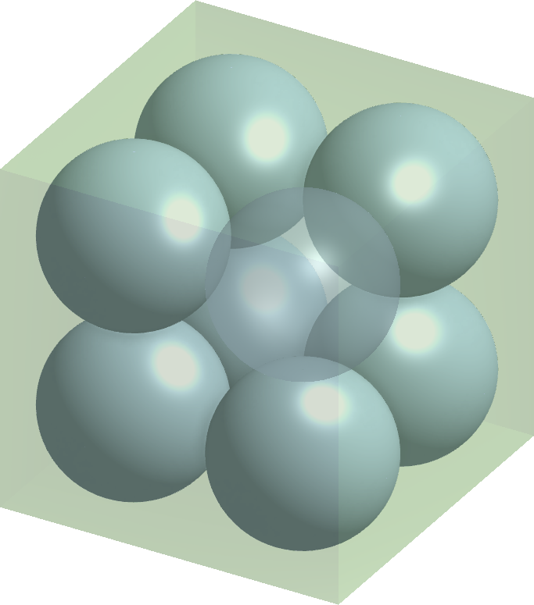
8 spheres paradox
4x4x4 cube
radius 1

Slide 24
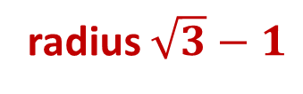
8 spheres paradox
4x4x4 cube
radius 1
radius $\sqrt{3}−1$
Notes:
Make a sphere centered at origin, the largest possible without intersecting the blue spheres: its radius is $\sqrt{3}−1$

Slide 25
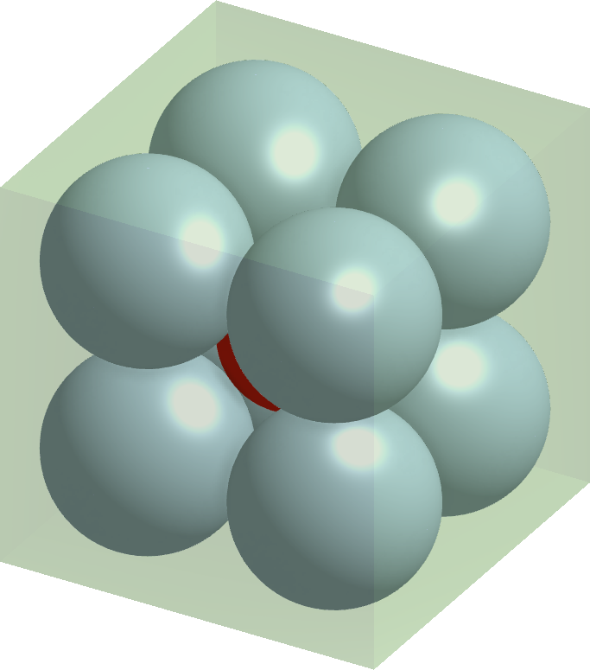
8 spheres paradox
4x4x4 cube
radius 1
radius $\sqrt{3}−1$

Slide 26
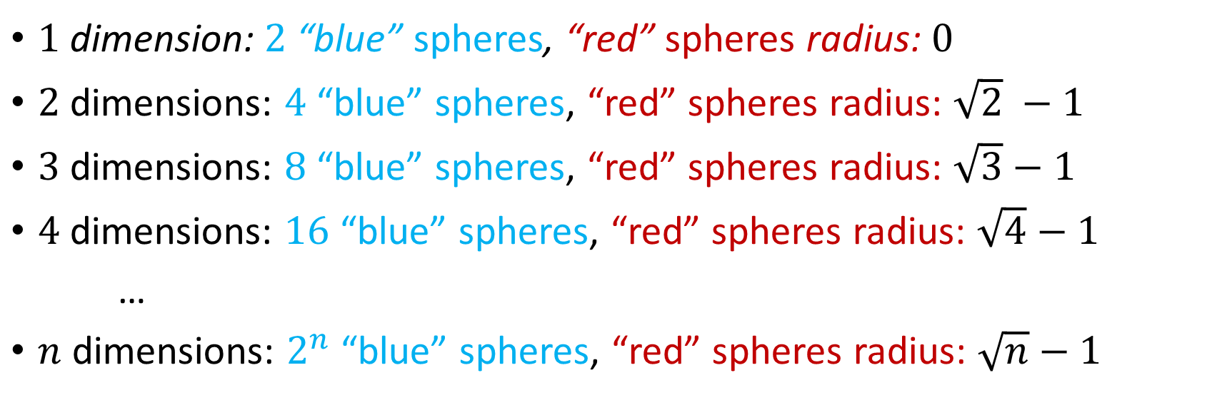
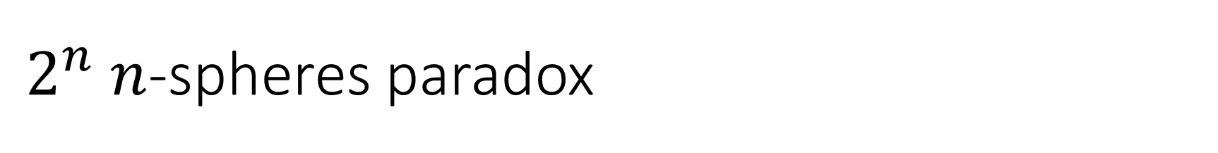
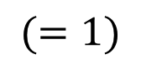
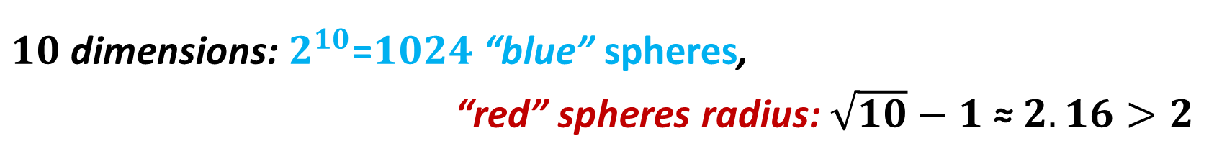
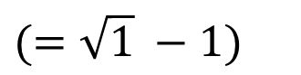
$2^{n}$ $n$-spheres paradox
$$(=\sqrt{1} −1)$$
$1$ dimension: $2$ “blue” spheres, “red” spheres radius: $0$
$2$ dimensions: $4$ “blue” spheres, “red” spheres radius: $\sqrt{2} −1$
$3$ dimensions: $8$ “blue” spheres, “red” spheres radius: $\sqrt{3}−1$
$4$ dimensions: $16$ “blue” spheres, “red” spheres radius: $\sqrt{4}−1$
…
$n$ dimensions: $2^{n}$ “blue” spheres, “red” spheres radius: $\sqrt{n}−1$
$$(=1)$$
$10$ dimensions: $2^{10}$=$1024$ “blue” spheres,
“red” spheres radius: $\sqrt{10}−1$ ≈ $2.16>2$

Slide 27
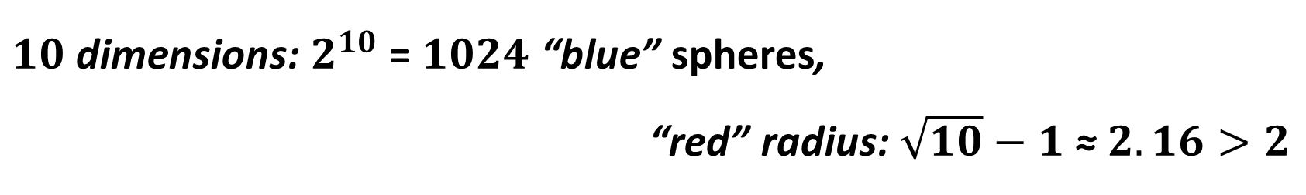
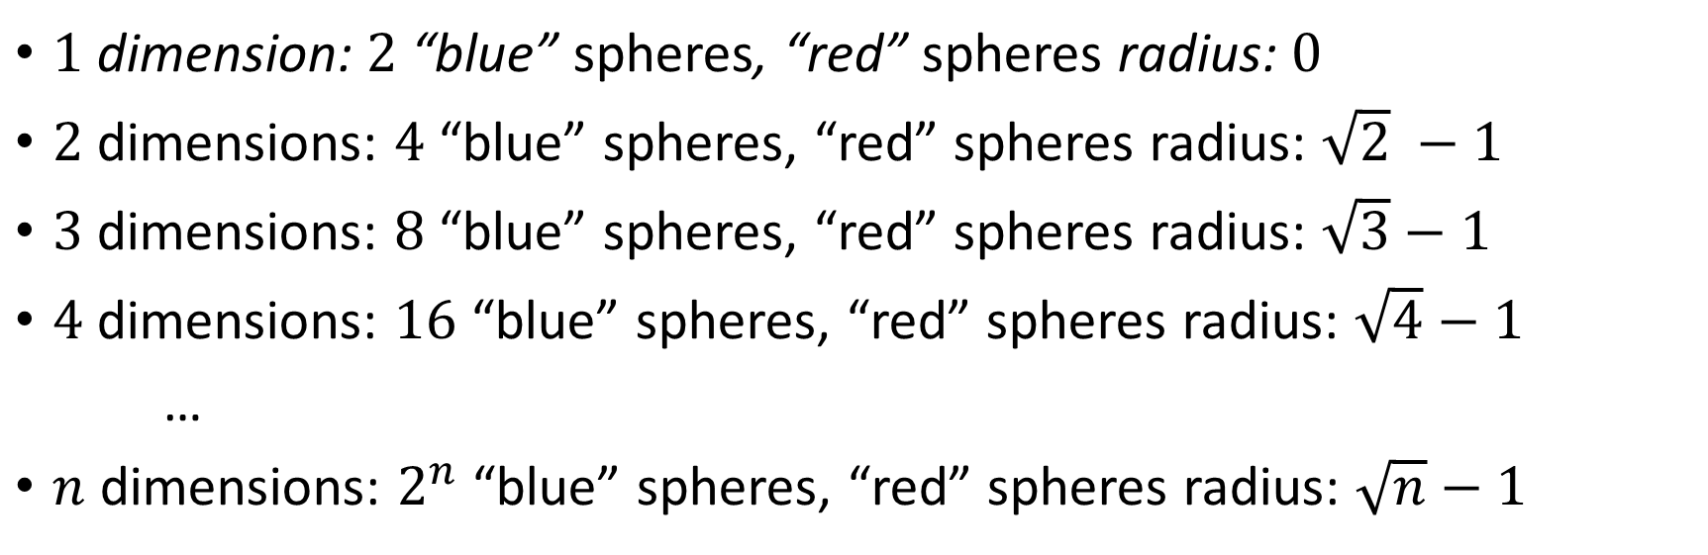
$2^{n}$ $n$-spheres paradox
$$(=\sqrt{1} −1)$$
$1$ dimension: $2$ “blue” spheres, “red” spheres radius: $0$
$2$ dimensions: $4$ “blue” spheres, “red” spheres radius: $\sqrt{2} −1$
$3$ dimensions: $8$ “blue” spheres, “red” spheres radius: $\sqrt{3}−1$
$4$ dimensions: $16$ “blue” spheres, “red” spheres radius: $\sqrt{4}−1$
…
$n$ dimensions: $2^{n}$ “blue” spheres, “red” spheres radius: $\sqrt{n}−1$
$$(=1)$$
$10$ dimensions: $2^{10}$ = $1024$ “blue” spheres,
“red” radius: $\sqrt{10}−1$ ≈ $2.16>2$
Notes:
N dim: make sure everyone agree with that formula
Then show the 10 dim
Actually, even 4 dim is a little weird

Slide 28
4 circles paradox

Slide 29
4 circles paradox
Notes:
This is wrong: the blue sphere still touch each other in high dimensions

Slide 30

8 spheres paradox

Slide 31
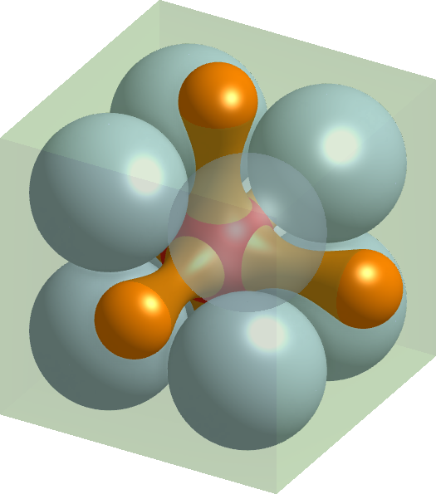
8 spheres paradox
Not Convex
Notes:
This is wrong: the red sphere remains convex in high dimensions

Slide 32
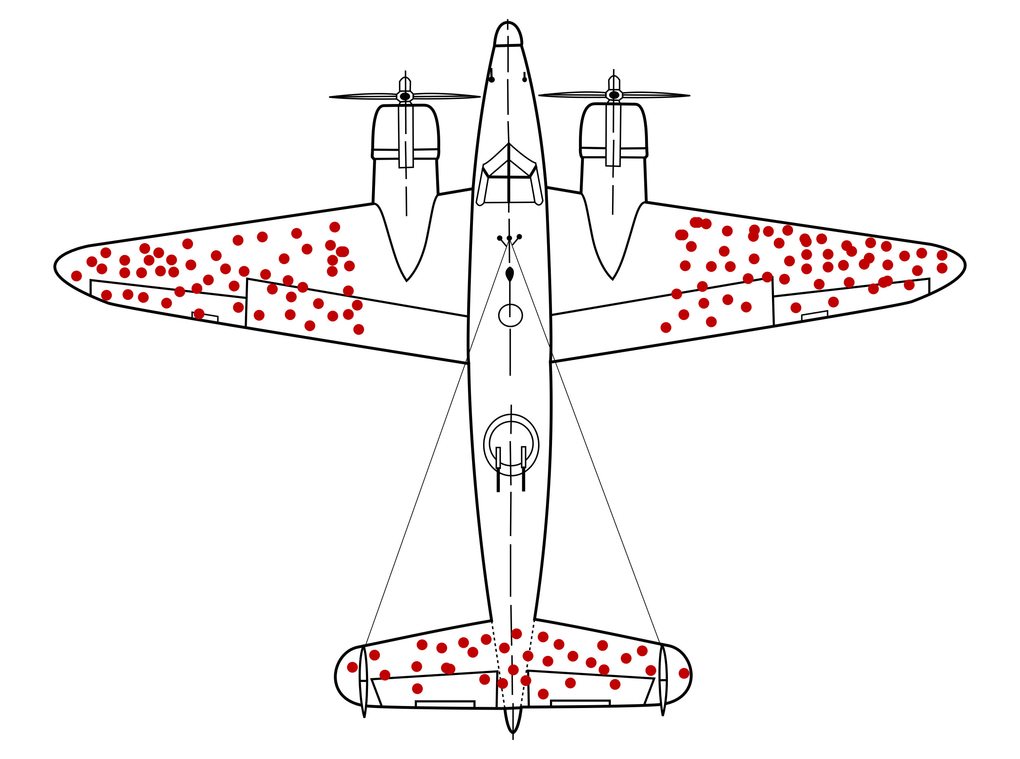
Statistics
Notes:
Royal Air Force story

Slide 33
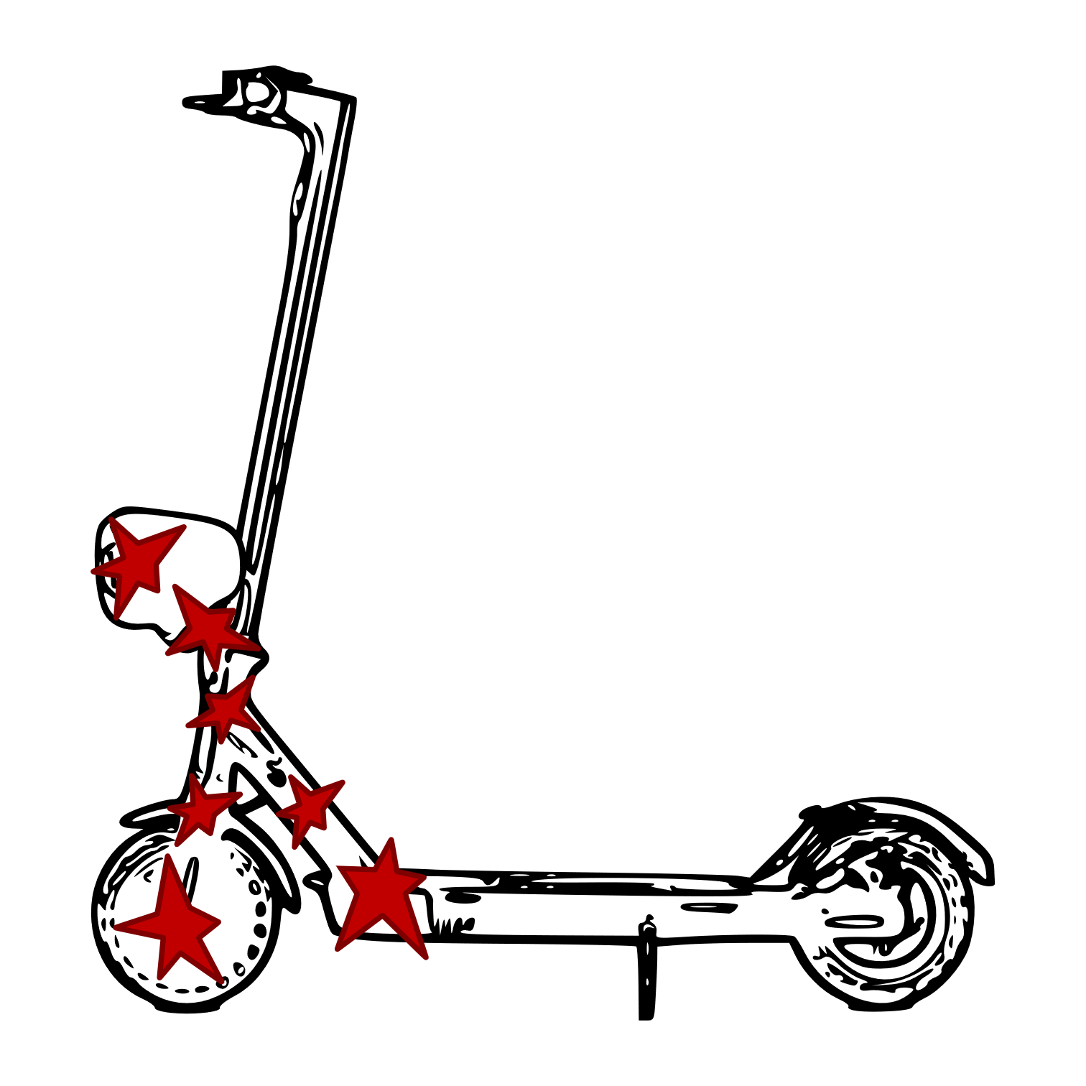
Over Interpretation
Notes:
Non-uniform damaging => cannot apply previous conclusion

Slide 34
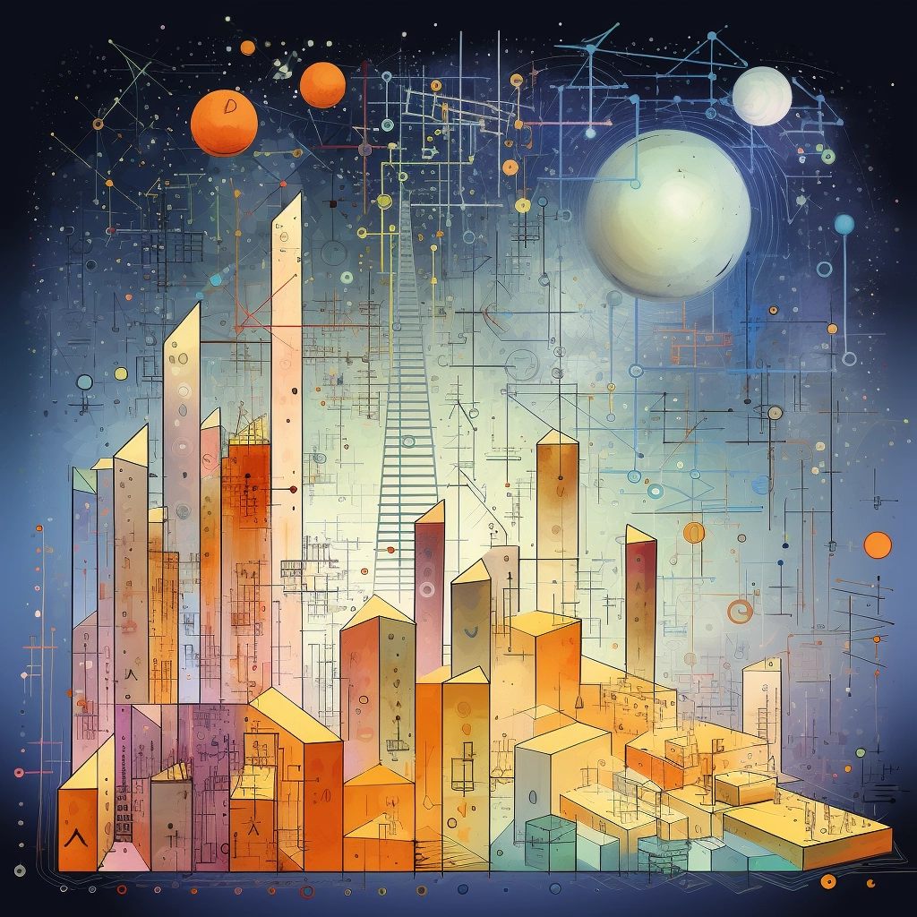



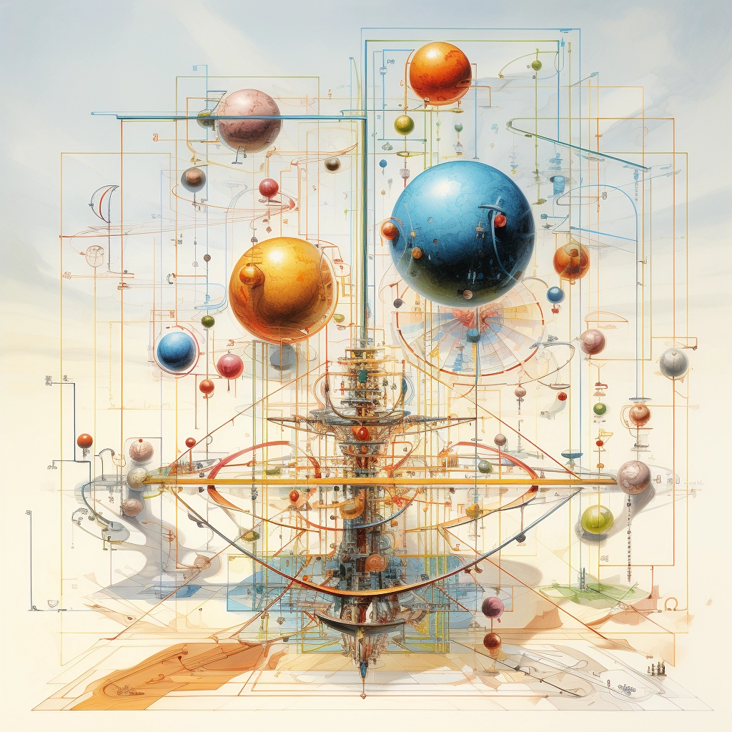
“high dimensions” (MidJourney)
Notes:
Final note: mid-journey’s illustration of “high dimensions”… is probably not useful… or is it?
Merry Christmas !

